Slide 1
HotelRevolution2014s
Data Flow Diagram and Database design

Slide 2
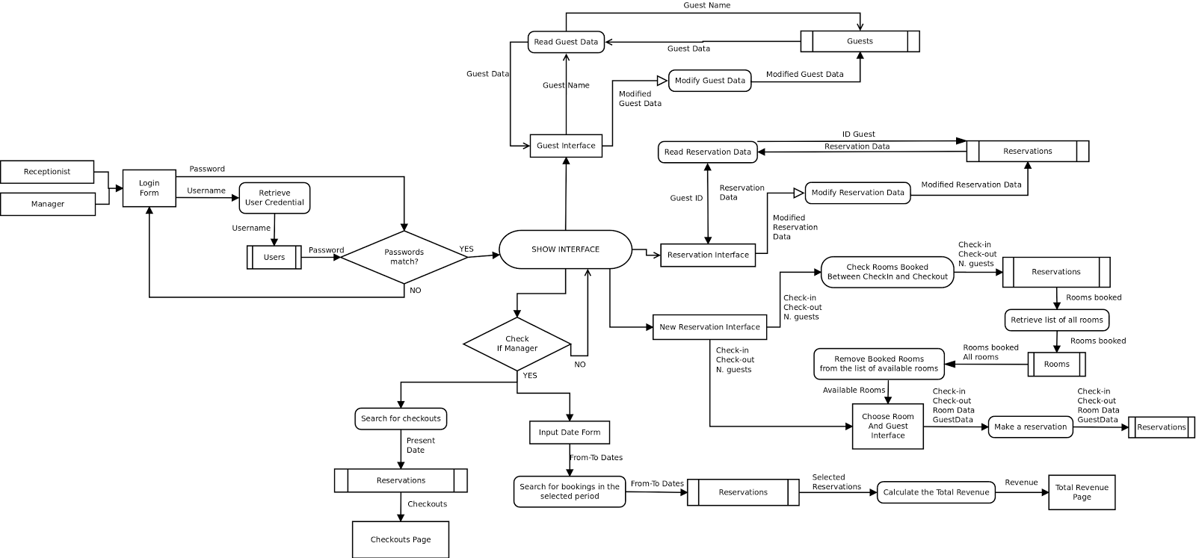
Data Flow Diagram

Slide 3
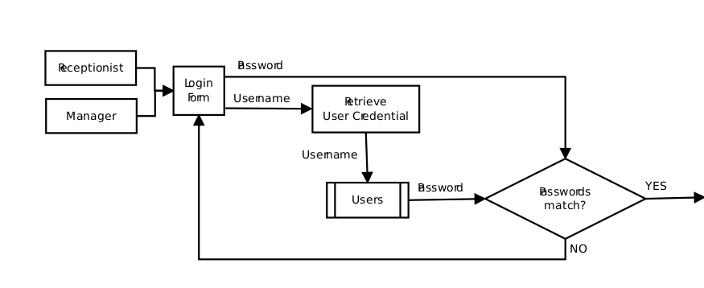
Login

Slide 4
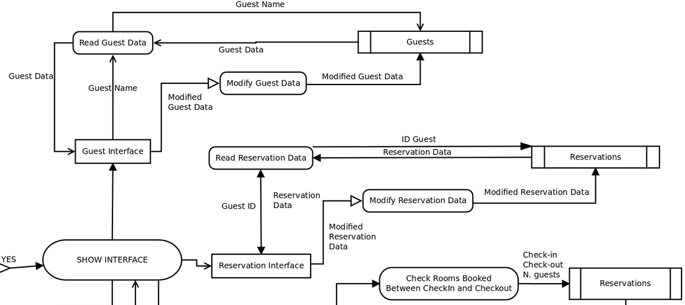
Guests and Reservations

Slide 5
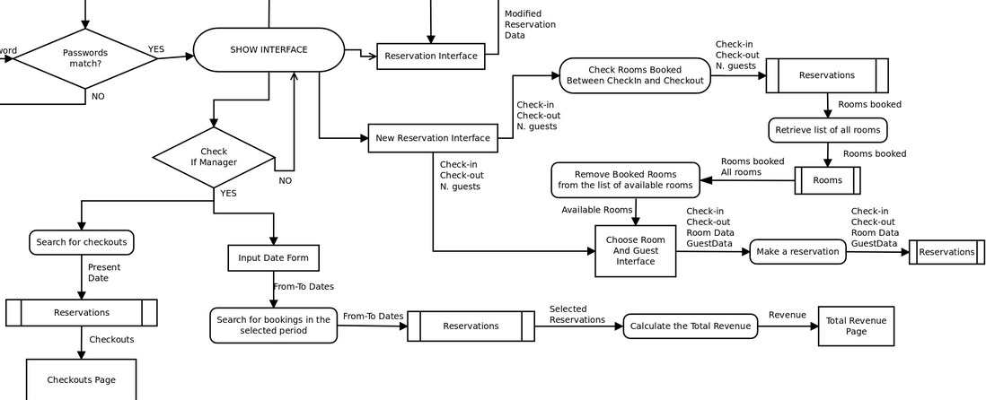
Booking and Manager Interface

Slide 6
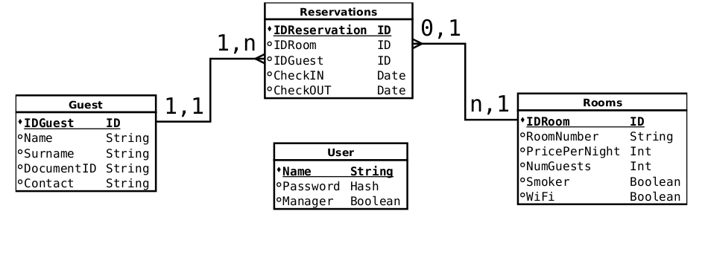
Database Design

